Slide 1
MATHEMATICAL MODELING:HARDY-WEINBERG
INVESTIGATION 2
BIG IDEA 1
By Cherylann Hollinger

Slide 2

Hardy-Weinberg Equilibrium
How can mathematical models be used to investigate the relationship between the allele frequencies in populations of organisms and evolutionary change?

Slide 3
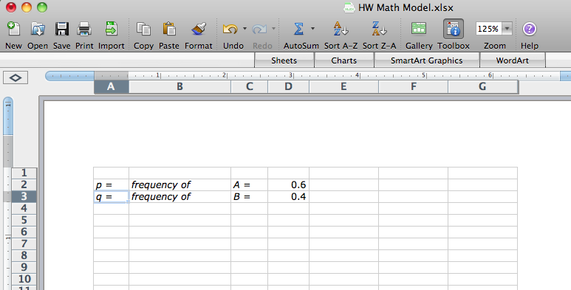
Using Excel to Model H-W
Insert values for the A and B alleles. Adjust the width of the columns.

Slide 4
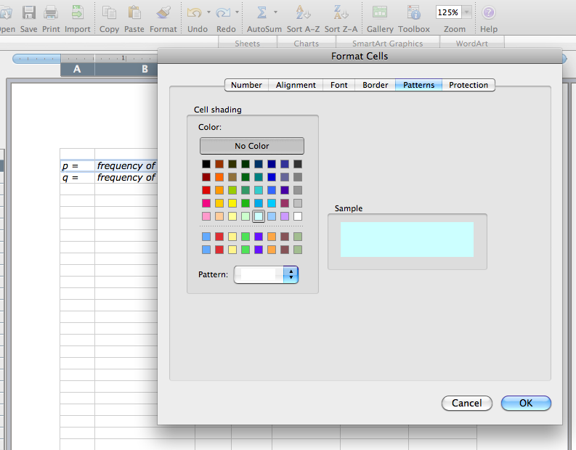
Using Excel to Model H-W
You can highlight the areas you wish to format with color by clicking on the “Format” tab followed by “Cells”, then “Patterns.”

Slide 5
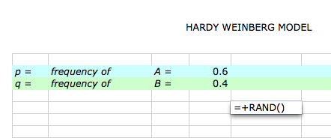
Using Excel to Model H-W
In a nearby empty cell, enter the function +Rand()
It will be removed later. Hit return. What do you find in the cell?

Slide 6
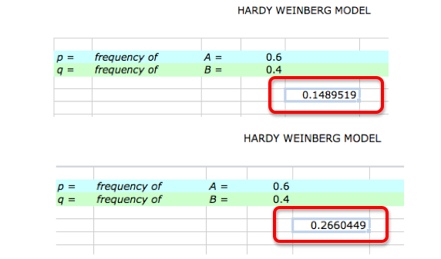
Using Excel to Model H-W
The RAND function returns random numbers between 0 and 1 in decimal format. By using this function, this model is simulates the “random” choosing of gametes from a gene pool.

Slide 7
Using Excel to Model H-W
Go ahead and delete the RAND function in the cell.
Select two gametes from the gene pool.
In cell E5, generate a random number, compare it to the value of p, and then place either an A gamete or a B gamete in the cell.
You will need two functions – the RAND function and the IF function.

Slide 8
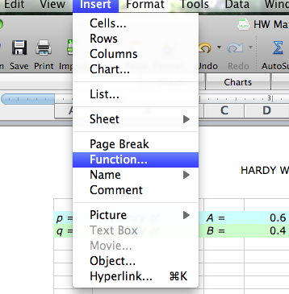
Using Excel to Model H-W
Click on the E5 cell, then go to the “Insert” tab. Click on “Function,” and type in the following function:
=IF(RAND()<=D$2, “A”, “B”)

Slide 9
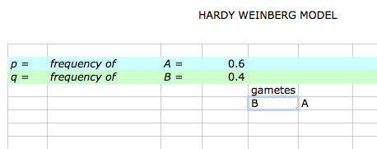
Using Excel to Model H-W
Your spreadsheet should look like this.

Slide 10
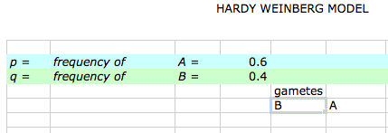
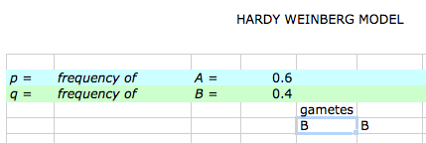
Using Excel to Model H-W
Try recalculating 10-20 times. This is what should happen.
The gametes change.

Slide 11
Using Excel to Model H-W
Copy these 2 formulas in E5 and F5 down for about 16 rows to represent gametes that will form 16 offspring for the next generation.
To copy the formulas, click on the bottom right-hand corner of the cell and, with your finger pressed down on the mouse, drag the cell downward.

Slide 12
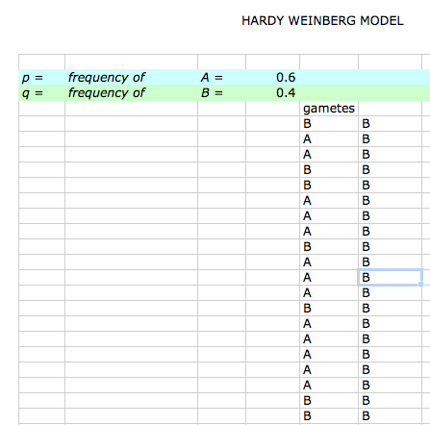
Using Excel to Model H-W
It should
look like
this.

Slide 13
Using Excel to Model H-W
The next step is to put the zygote in cell G5.
In cell G5, enter the function
= CONCATENATE(E5,F5)
and then copy this formula down as far as you have gametes.

Slide 14
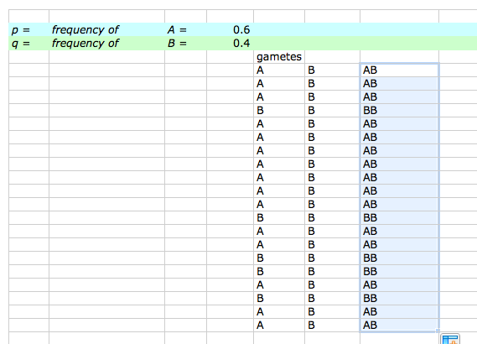
Using Excel to Model H-W
It should look like this.

Slide 15
Using Excel to Model H-W
The next columns on the spreadsheet are H, I, and J.
These are “housekeeping” columns.
They keep track of the numbers of each zygote’s genotype. You will enter the following functions for each column.
The function in cell H is =IF(G5=”AA”,1.0).
The function in cell J is =IF(G5=”BB”,1.0).
In cell I5, enter this function: =IF(G5=”AB”,1,(IF(G5=”BA”,1.0))).
Enter the labels for the columns you have been working on. Cell E4 gametes, Cell G5 AA in cell H4, and BB in Cell J4.

Slide 16
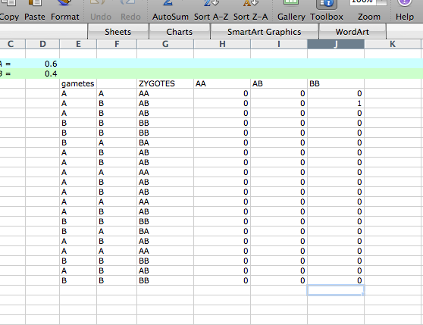
Using Excel to Model H-W
It should
look like
this.

Slide 17
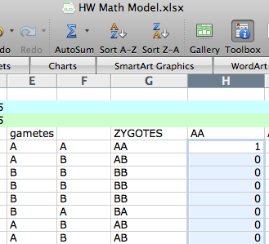
Using Excel to Model H-W
Use the SUM function to calculate the numbers of each genotype in the H,I, and J columns.

Slide 18
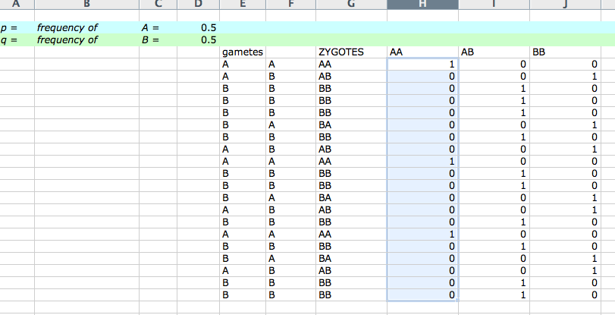
Using Excel to Model H-W
It should look like this.

Slide 19
Using Excel to Model H-W
Try recalculating a number of times to make sure everything is working as expected.
Don’t go on until you are sure the spreadsheet is making correct calculations.
Try different values for p.
Make sure the number of zygotes adds up.

Slide 20
Using Excel to Model H-W
To calculate the number of each allele as shown in Figure 8:
Several cells below the chart set up the following:
A B
number of each allele

Slide 21
Using Excel to Model H-W
To calculate each allele use the following function:
=COUNTIF(E5:F20, "A") for the A allele
AND
=COUNTIF(E5:F20, “B") for the B allele
(the cells in red must be customized according to where the gametes are located in your individual spreadsheet)

Slide 22
Using Excel to Model H-W
Make a bar graph of the genotypes using the chart tool. Your graph should resemble what is on the next slide.
All you need to do is add the title and label the X and Y axes.

Slide 23
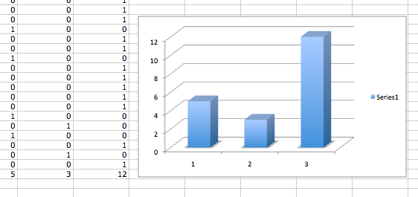
Using Excel to Model H-W

Slide 24
Using Excel to Model H-W
To calculate the allele frequency of the next generation:
=H24/(H24+J24) for p
and
=J24/(H24+J24) for q
(the cells in red must be customized according to where the gametes are located in your individual spreadsheet)

